Slide 1
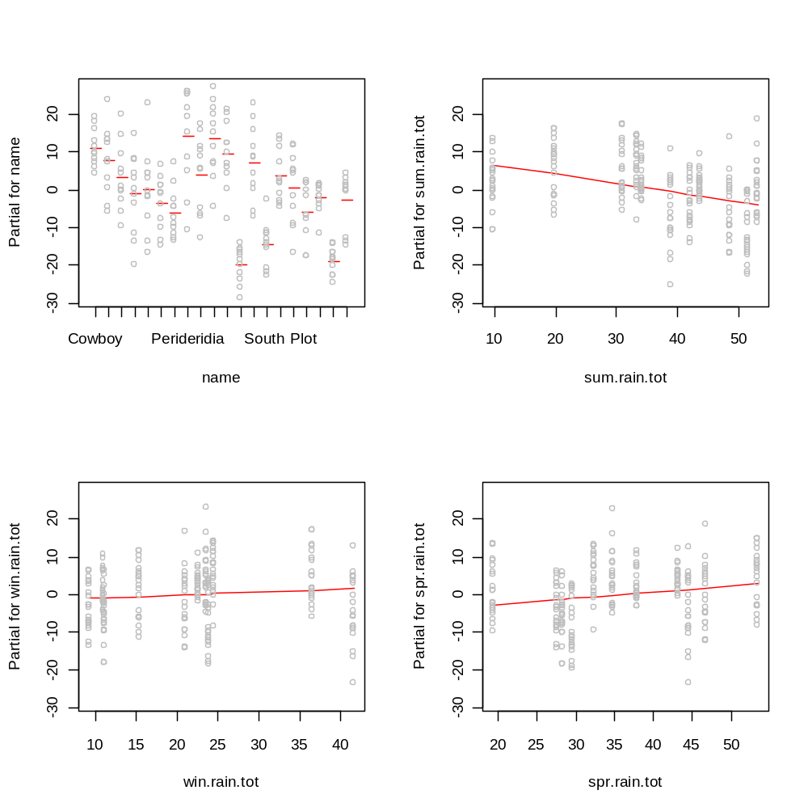
Partial residual plots of the model:
Richness ~ plot + seasonal rainfall
100 m2

Slide 2
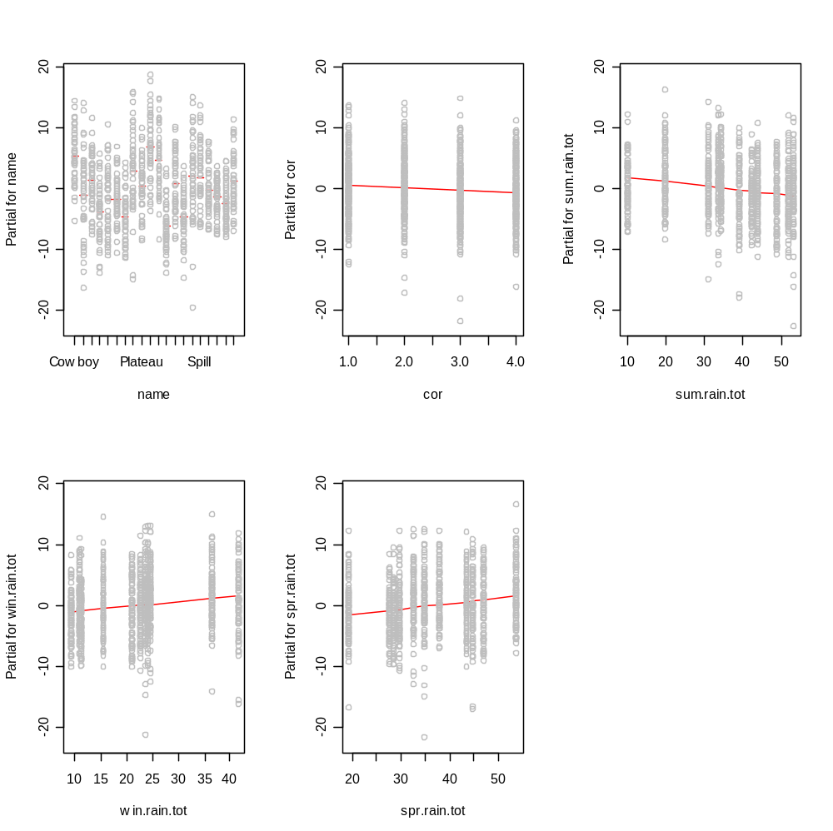
Partial residual plots of the model:
Richness ~ plot + corner + seasonal rainfall
1 m2

Slide 3
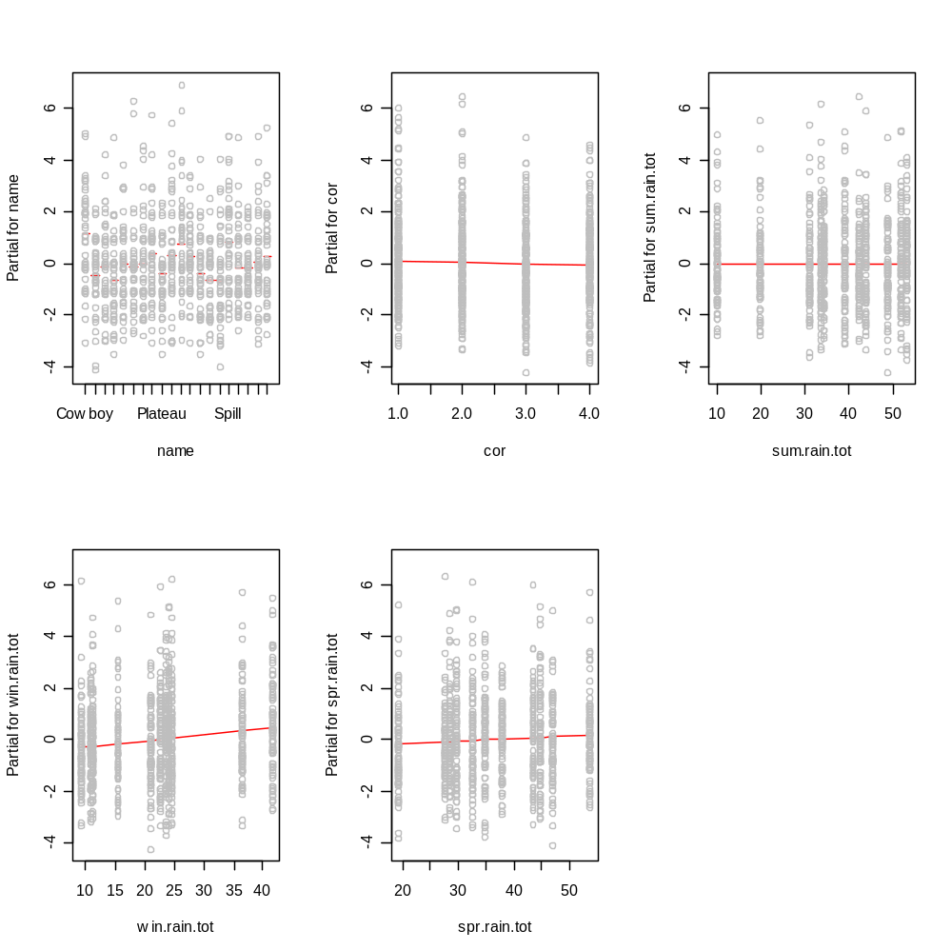
Partial residual plots of the model:
Richness ~ plot + corner + seasonal rainfall
0.01 m2

Slide 4
--Mixed-effect model output when all the data except 100 m2 is included (b/c corner is not replicated at that scale) in the same model
--Random effects include level within corner within plot (i.e., these effects are factored out)
--Temporal AR1 model included
Value Std.Error DF t-value p-value
(Intercept) 66.314 1.696 3191 39.104 0.000
dist.mYrsOB 0.354 0.043 3191 8.315 0.000
dist.mBP5Yrs -0.571 0.135 3191 -4.241 0.000
dist.mYrsSLB -0.574 0.059 3191 -9.761 0.000
lv -13.318 0.414 239 -32.205 0.000
sum.rain.tot -0.234 0.018 3191 -13.349 0.000
win.rain.tot 0.142 0.023 3191 6.102 0.000
spr.rain.tot 0.226 0.025 3191 9.060 0.000
lv:sum.rain.tot 0.051 0.005 3191 10.708 0.000
lv:win.rain.tot -0.020 0.006 3191 -3.105 0.002
lv:spr.rain.tot -0.043 0.007 3191 -6.262 0.000
These interaction terms demonstrate that as spatial grain becomes finer (i.e., lv increases) that the magnitudes of the effects decrease towards zero (just as the preceding figures demonstrate).

Slide 5
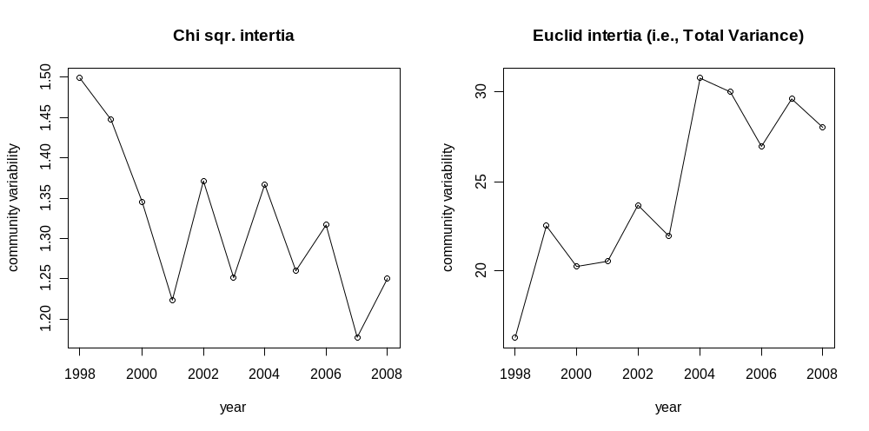
Total Community Variability Through time
correspondence analysis
principle components analysis
Why do you think these differ?

